Slide 1
OOP Using Java
By: Ghulam Mujtaba Shaikh

Slide 2
JDBC
PART-I

Slide 3
Topics for Discussion
Introduction to JDBC
Creating the Database
Creating a DSN
Steps for JDBC
Simple Example

Slide 4
Introduction to JDBC
JDBC provides a standard library for accessing relational database.
API standardizes way
  Way to establish connection to DBs
  Approach to initiate queries
  Methods to initiate parameterized queries
  The data structure of query result (table)
  Determining the no. of columns
  Looking up meta data etc.
API does not standardize SQL.
JDBC is not embedded SQL
JDBC located in java.sql package.

Slide 5
Connecting MS Access
Create PerosnalInfo database
Create Person table
Make the following fields
  ID
  Name
  Address
  Phone
Create DSN (Data Source Name)

Slide 6
How to Create DSN
Go to Settings
Go to Control Panel
Go to Administrative Tools
Go to Data Source (ODBC)
Click System DSN
Click Add
Click Microsoft Access Driver (*.mdb)
Click Finish
Give Data source Name (Person DSN)
Click the select button and select the database
Click ok

Slide 7
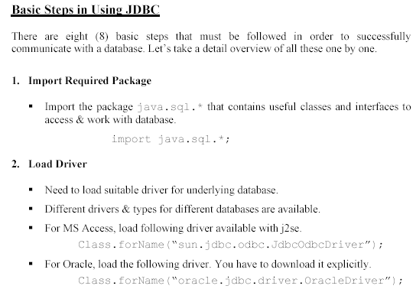

Slide 8
3- Define Connection URL:
To get a connection, we need to specify the URL of a database
As we are using MS Access database and we have loaded a JDBC-ODBC driver. Using JDBC-ODBC
driver requires a DSN which we have created earlier and named it personDSN. So, the URL of a database will be
String conURL = "jdbc:odbc:personDSN" ;

Slide 9
4- Establishing connection with a database
Use DriverManager to get the connection object.
The URL of the database is pass to the getConnection () method.
Connection con = DriverManager.getConnection (conURL) ;
If database requires username and password. You can use the overloaded
method of the getConnection () method as shown below;
String user = "Mujtaba" ;
String pw = "SIBA" ;
Connection con = null ;
con = DriverManager.getConnection (conURL , user , pw) ;

Slide 10
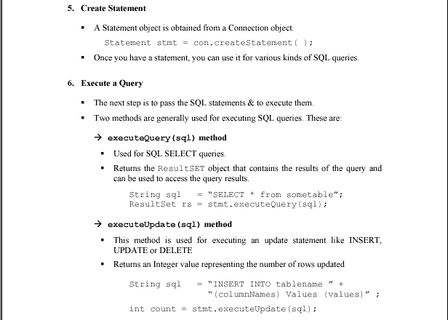

Slide 11
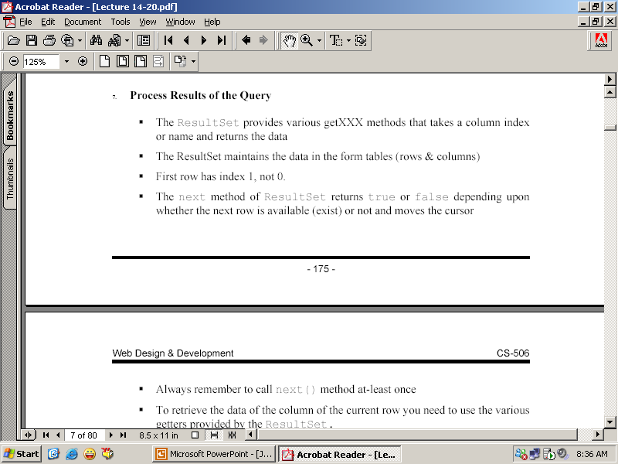
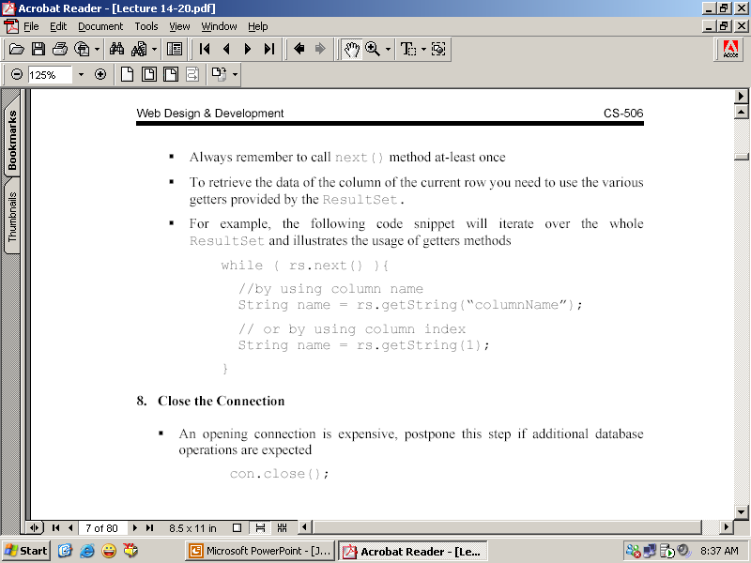

Slide 12
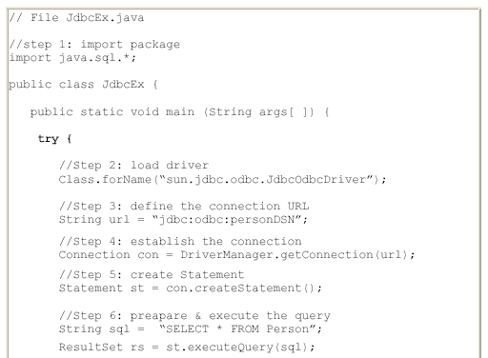

Slide 13
